Slide 1

Receipt & Invoice Digitiser
A comprehensive solution for converting physical receipts into structured digital data through advanced optical character recognition and intelligent processing.
KAVETI HARINI
harinikaveti2003@gmail.com

Slide 2
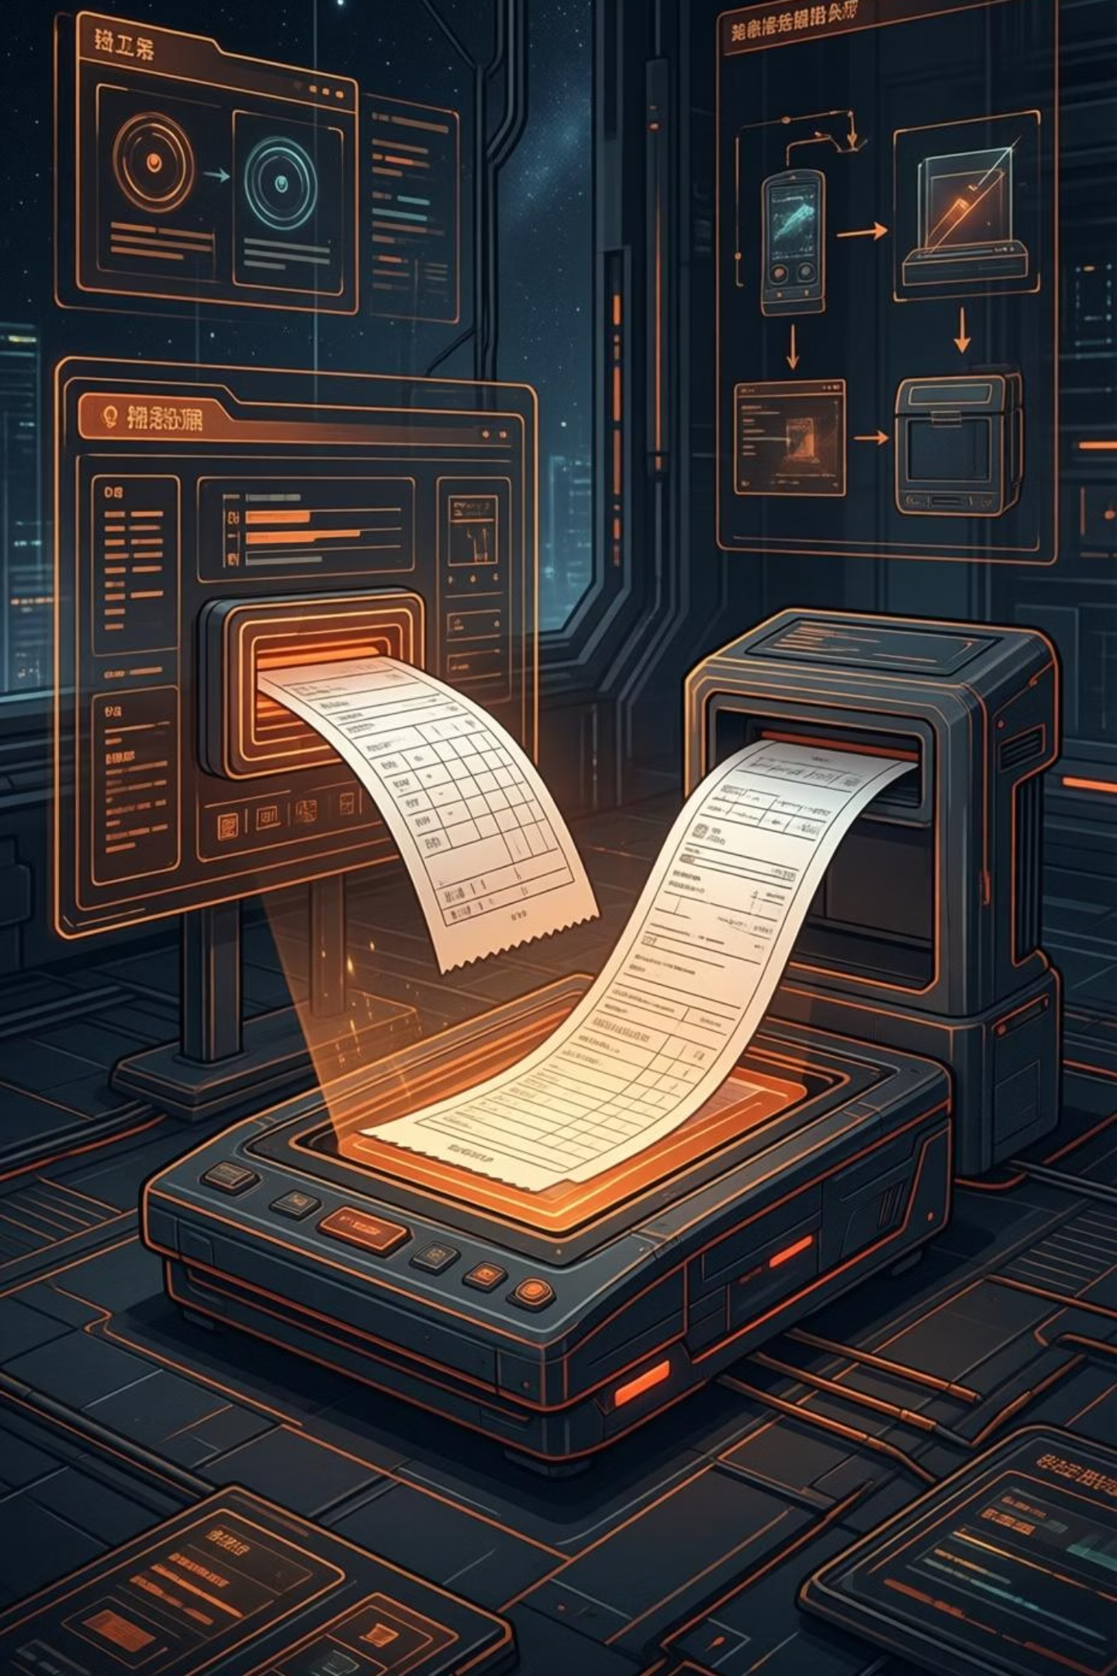




Milestone 1 Objective
Upload Receipt Files
Enable users to seamlessly upload receipt images in multiple formats for processing.
Clean Images for OCR
Apply advanced preprocessing techniques to enhance image quality and readability.
Extract Raw Text
Convert visual receipt data into machine-readable text format using OCR technology.
Core Focus: This milestone concentrates on transforming physical receipts into readable, structured text data that can be further processed and analysed.

Slide 3
Technologies Used
Our solution leverages a carefully selected technology stack that combines powerful libraries and frameworks to deliver robust document processing capabilities.
Streamlit
OpenCV
Tesseract OCR
Python
Provides an intuitive web-based user interface for seamless interaction and file management.
Handles sophisticated image preprocessing and enhancement operations for optimal OCR results.
Industry-leading optical character recognition engine for accurate text extraction from images.
Powers the backend logic, orchestrating all components and ensuring smooth data flow.

Slide 4
Project Timeline – Milestone 1
Module | Timeline | Work Done
File Upload Module | Week 1 (Day 1–2) | Implemented image & PDF upload using Stream lit
PDF to Image Conversion | Week 1 (Day 3) | Converted PDF pages using pdf2image
Image Preprocessing | Week 1 (Day 4–5) | Gray scale, noise removal, contrast enhancement
OCR Text Extraction | Week 2 (Day 1–2) | Extracted text using Tesseract OCR
Testing & Validation | Week 2 (Day 3–4) | Tested with sample receipts and verified output

Slide 5
1
File Upload Implementation
File Selection
st.file_uploader() interface
Document Ingestion System
2
Our robust file upload mechanism supports multiple formats to accommodate various receipt types and sources. The system intelligently handles different file formats whilst maintaining data integrity throughout the ingestion process.
Format Detection
Automatic file type identification
JPG & PNG formats for standard image receipts
3
PDF support with multi-page document handling
Streamlit integration for user-friendly uploads
PDF Processing
pdf2image conversion for PDFs

Slide 6
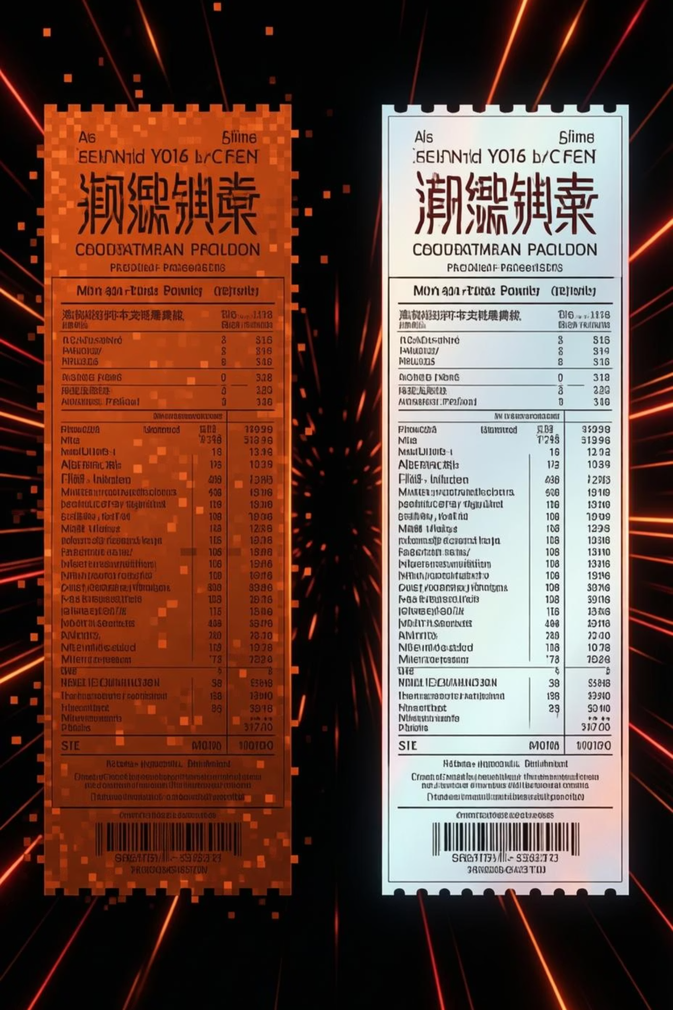



Image Preprocessing
Receipt images often suffer from quality issues such as poor lighting, blur, or noise that significantly impact OCR accuracy. Our preprocessing pipeline addresses these challenges through a series of sophisticated enhancement techniques.
Grayscale Conversion
Simplifies image data whilst preserving essential text information for processing.
Contrast Enhancement
CLAHE algorithm improves text visibility and sharpness across varying lighting conditions.
Noise Removal
Gaussian blur filtering eliminates unwanted artifacts and smooths image texture.
Effective preprocessing can improve OCR accuracy by up to 40%, transforming challenging receipts into clean, readable documents.

Slide 7
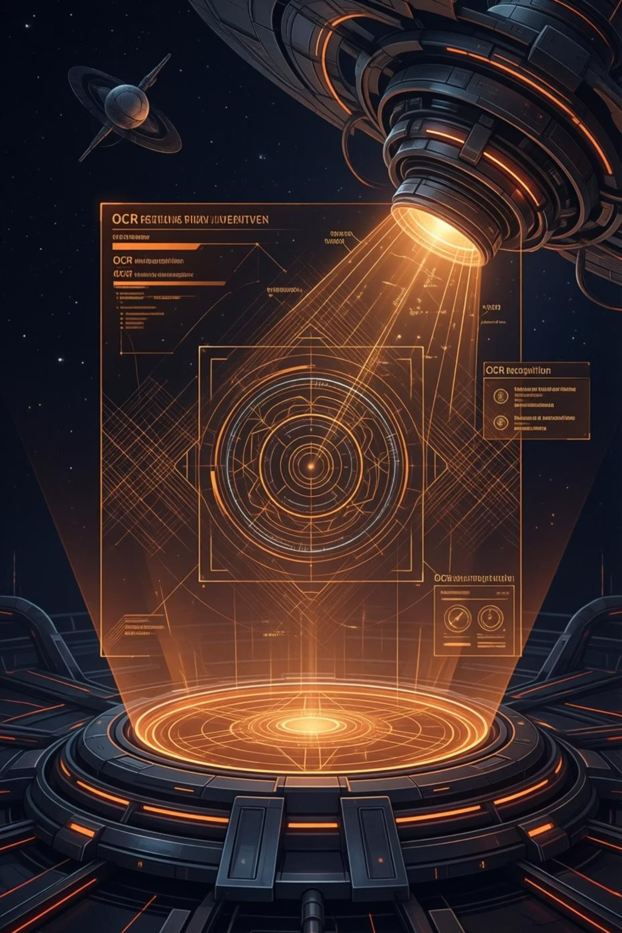
OCR Text Extraction
Optical Character Recognition
01
At the heart of our system lies Tesseract OCR, a powerful open-source engine that converts preprocessed images into machine-readable text. The extraction process analyses character patterns, recognises text structures, and outputs formatted data.
Image Input
Preprocessed receipt image loaded into memory
02
Character Recognition
The pytesseract.image_to_string() function serves as our primary interface, processing cleaned images and returning comprehensive text output that captures all visible information from the receipt.
Tesseract analyses and identifies text patterns
03
Text Assembly
Characters combined into words and sentences
04
Output Generation
Structured text data returned for processing

Slide 8
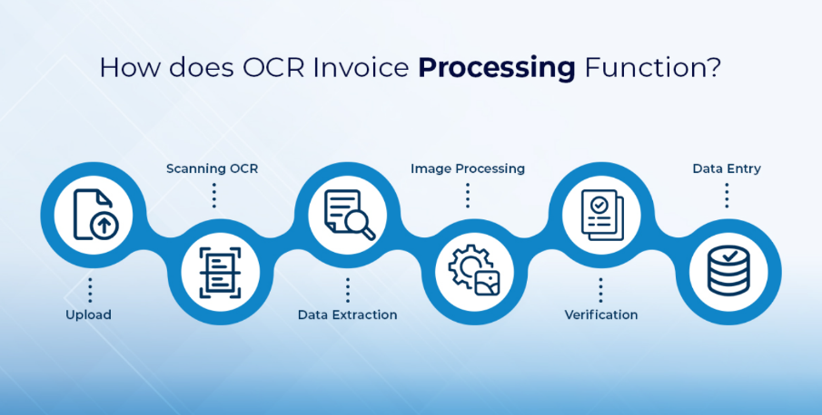
Process Flow Diagram:

Slide 9
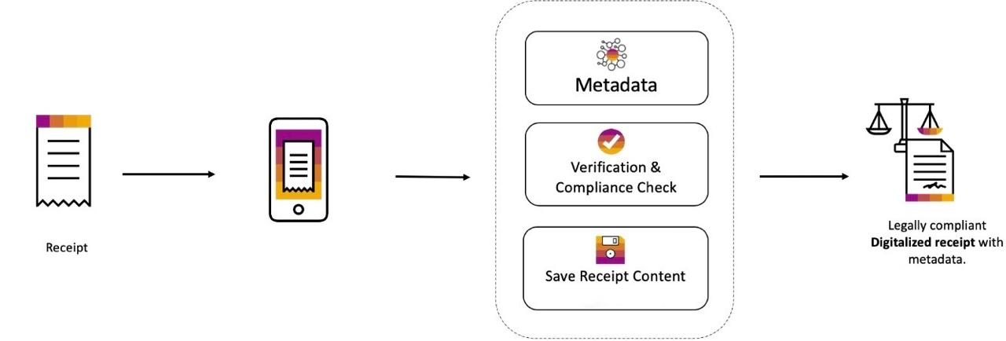
Architectural Design

Slide 10
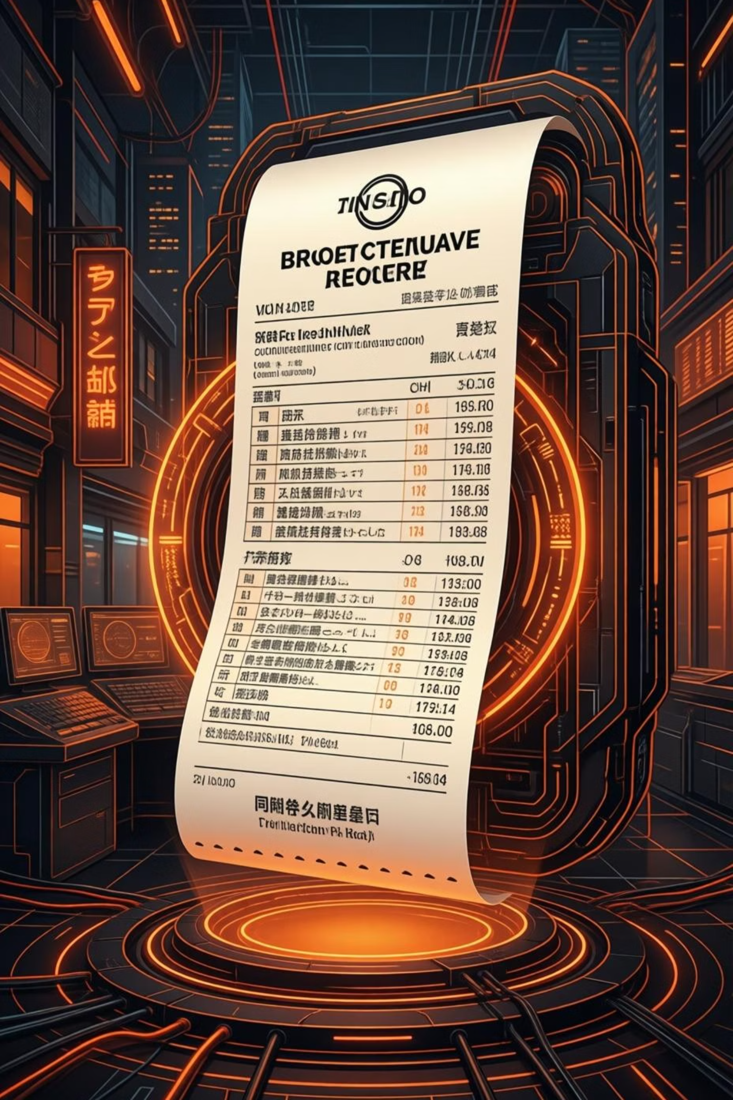
Sample Output
The OCR extraction process successfully captures critical information from receipts, transforming visual data into structured text that can be further analysed and processed.
Merchant Information
Business name, location, and contact details extracted from receipt header.
Transaction Details
Date, time, and transaction reference numbers captured accurately.
Financial Data
Total amount, tax breakdown, and payment method information extracted.
Example extracted text: "ABC Supermarket | Date: 15/03/2024 | Time: 14:30 | Total: ₹1,250.00"

Slide 11

Thank You

